Slide 1
MyTaxiService - RASD
Software Engineering 2 AA 2015-2016
Andrijana Mirchevska (838622)
Marija Mavcheva (838647)

Slide 2
Overview
Scenarios
UML Models
Use Case Diagrams
Class Diagram
Sequence Diagrams
State Chart Diagrams
Alloy Modeling
Alloy Code
Alloy Worlds
Introduction
Purpose
Scope
Glossary
Overall Description
Identifying stakeholders and actors
User characteristics
Goals and assumptions
Domain properties
Requirements
Functional requirements
Non-functional requirements

Slide 3
Scope
The project is about developing an application that will enable fast and optimized taxi services in the city
The application will allow users to register and then sign in into the app for using its services
Also taxi drivers can register and sign into the myTaxiService application with the purpose to manage their availability and duties

Slide 4
Identifying stakeholders
Company - requires project specification and expects it to be delivered while respecting the set deadlines and budget
Developer group - in this case group of two people
Taxi driver - worker at the company that ordered the software product
Passenger - person who need a ride to specific location

Slide 5
Actors identifying
Guest – can access the system but has never registered or still hasn`t logged in
User – already registered and logged into the system. The user can access and manage with all the services that the application offers
Taxi Driver - already registered and logged into the system. The driver can access and manage with all the services that the taxi driver application offers
Admin - is the person that is responsible for handling reports on users and drivers of my taxi service

Slide 6
Goals
myTaxiService should have these features:
registering a new user
sending notification about taxi availability
confirming about the reserved vehicle, its code and waiting time
managing user profile
ban user/driver
for each user it should provide:
logging in to his/her profile
making reservation
requesting taxi
canceling reservation
reporting driver
for each taxi driver it should provide:
logging in to his/her profile
confirming/declining a request for taxi call
reporting user

Slide 7
Domain properties
user making reservation from a specific location to a specific destination
taxis are organized into taxi zones
the payment process is irrelevant to the system, it`s done between the passenger and driver

Slide 8
Assumptions
Facts that resolve ambiguities:
user registers with email and password, and can change them
user can only have one account
there is a Terms & Conditions
we assume that Google Maps service will calculate location accurately
if the taxi driver does not respect the waiting time, he is banned from the system
if there are any irregularities with the taxi driver, new vehicle is sent to the passenger

Slide 9
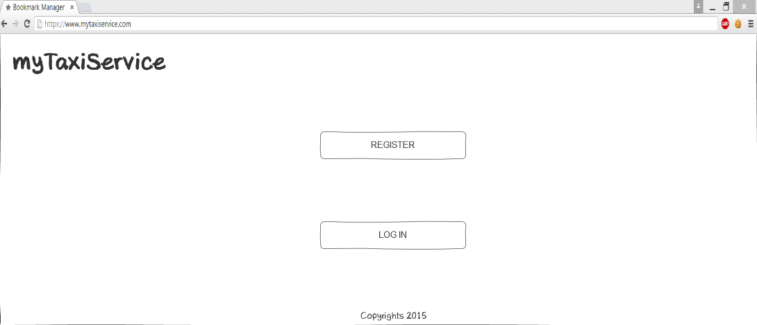
User-interface
Sketches for the web version of the application
Initial page

Slide 10
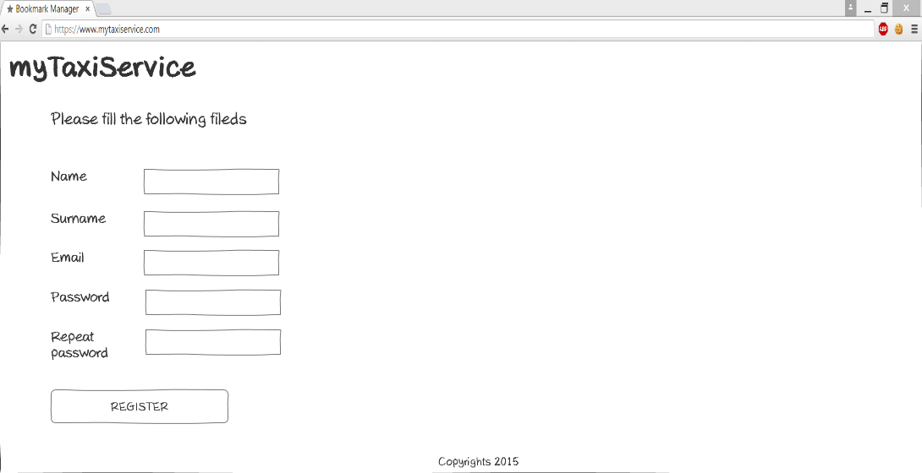
User-interface
Register page

Slide 11
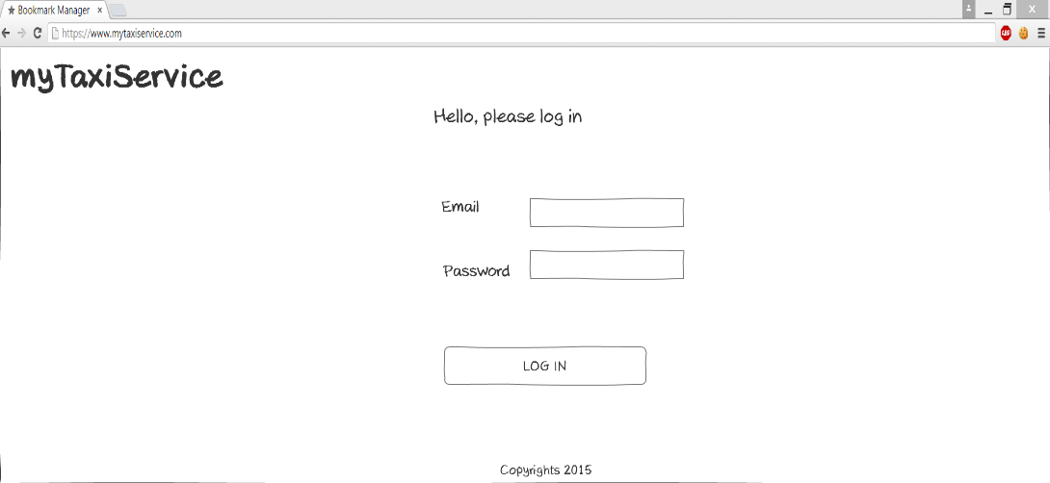
User-interface
Login page

Slide 12
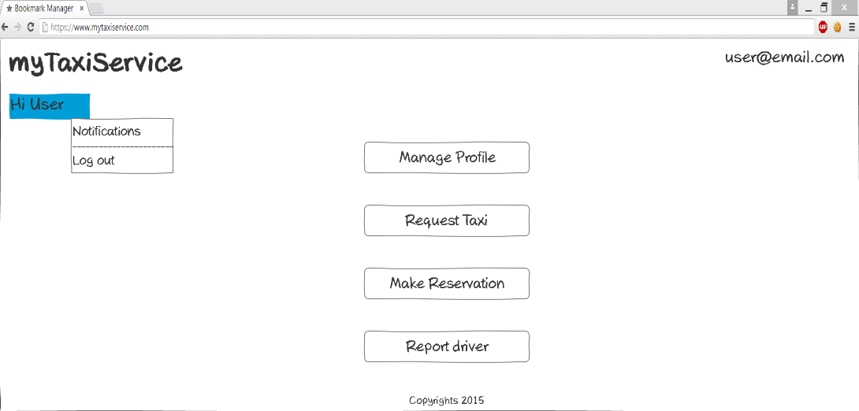
User-interface
Homepage

Slide 13
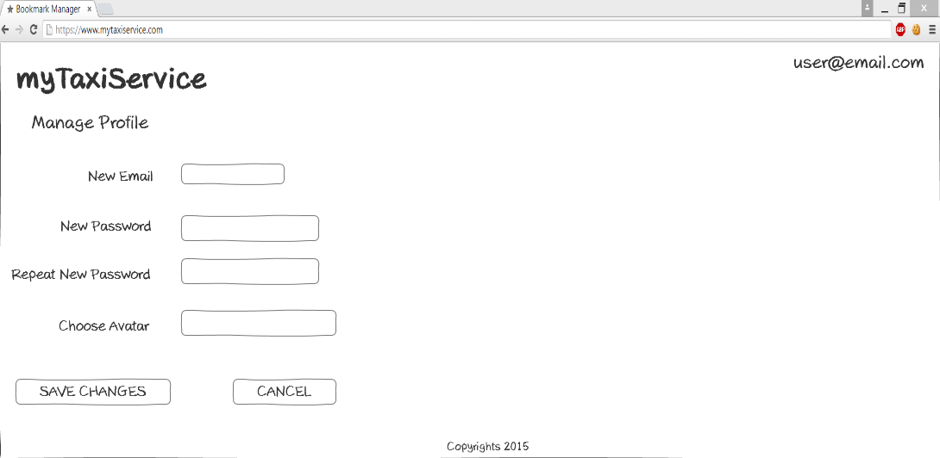
User-interface
Manage profile page

Slide 14
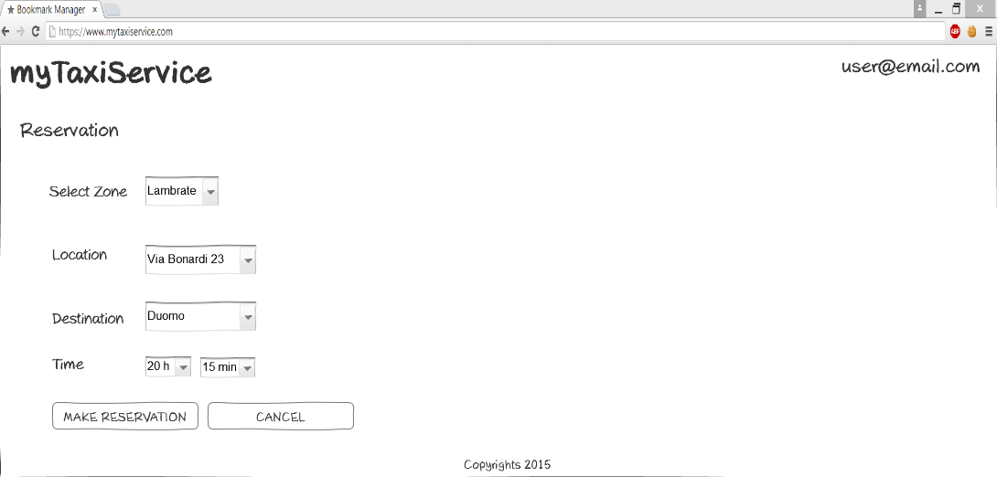
User-interface
Reservation taxi page

Slide 15
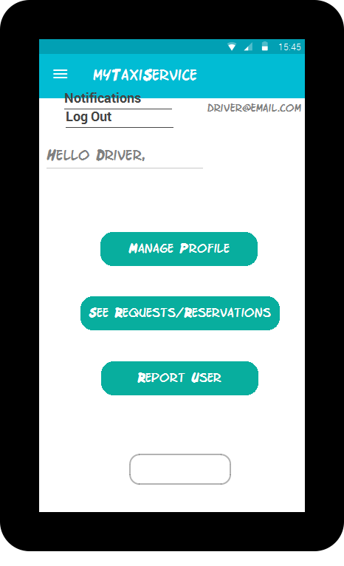
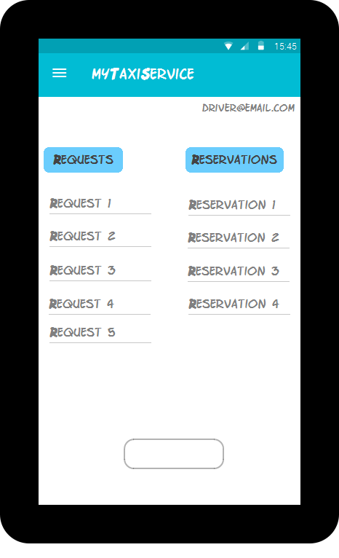
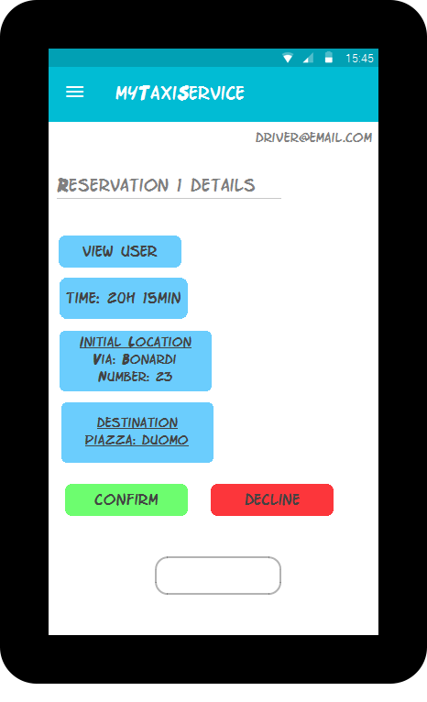
User-interface
Sketches for the mobile version of the application
Driver homepage
Notification page
Reservation details page

Slide 16
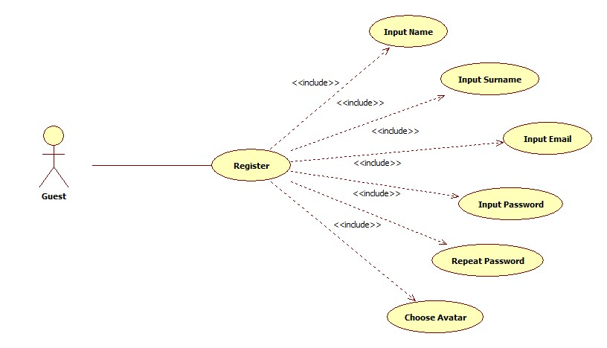
Use Case Diagrams
Register (accessing the application)

Slide 17
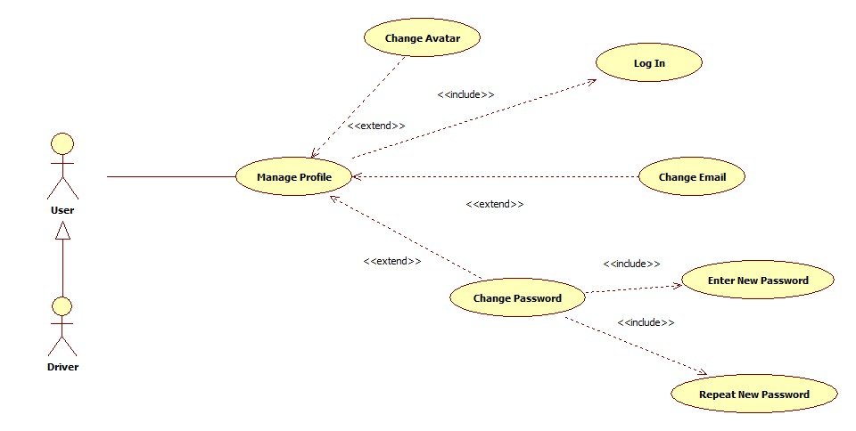
Use Case Diagrams
Manage Profile

Slide 18
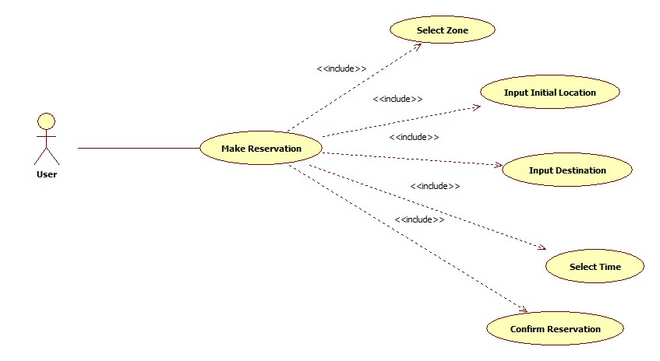
Use Case Diagrams
Make Reservation

Slide 19
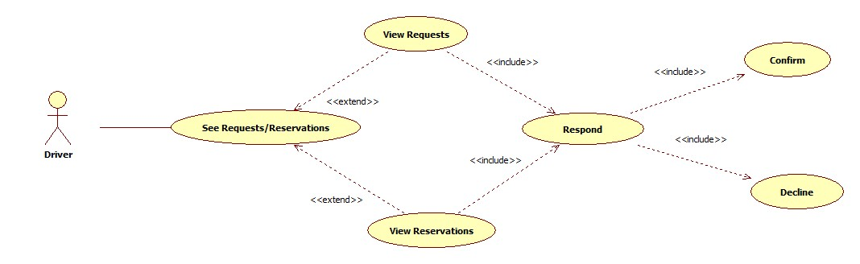
Use Case Diagrams
Driver`s Respond to a Request or Reservation

Slide 20
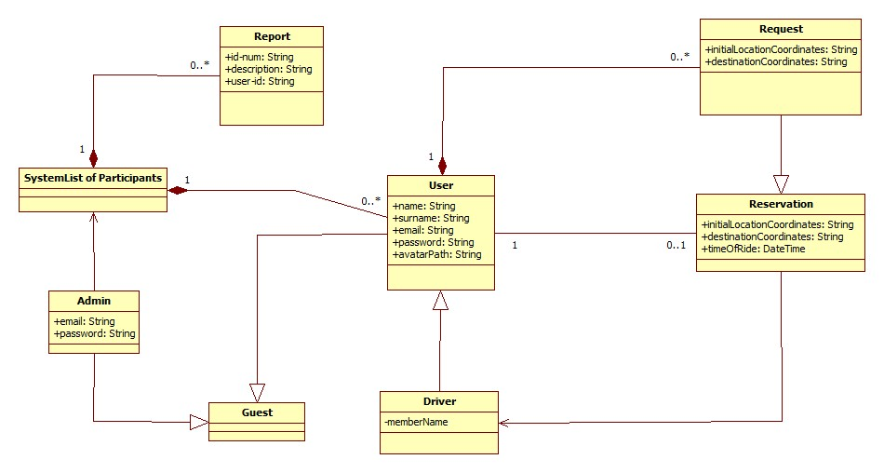
Class Diagram

Slide 21
Sequence Diagrams
Register

Slide 22
Sequence Diagrams
Reserve
taxi

Slide 23
Sequence Diagrams
Confirm/Decline
a ride

Slide 24
State Chart Diagram
Reservation
Lifecycle

Slide 25
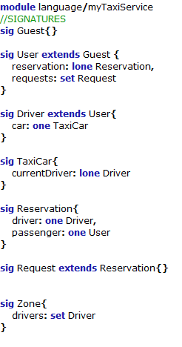
Alloy code

Slide 26
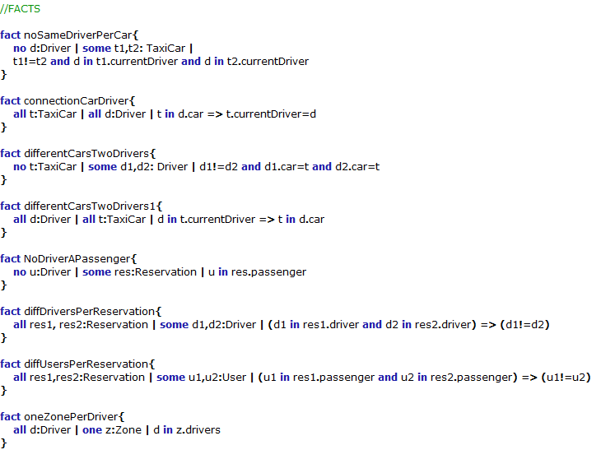
Alloy code

Slide 27
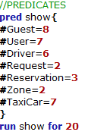
Alloy code

Slide 28
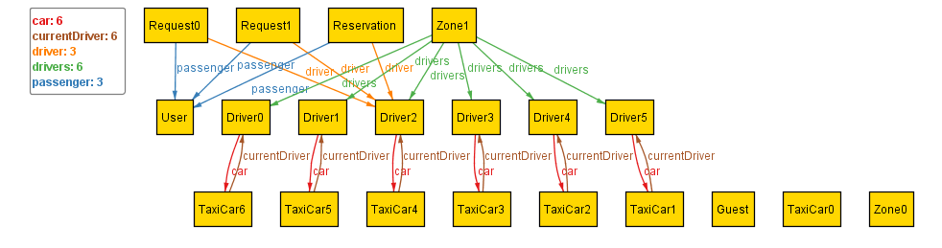
World Generated

Slide 29
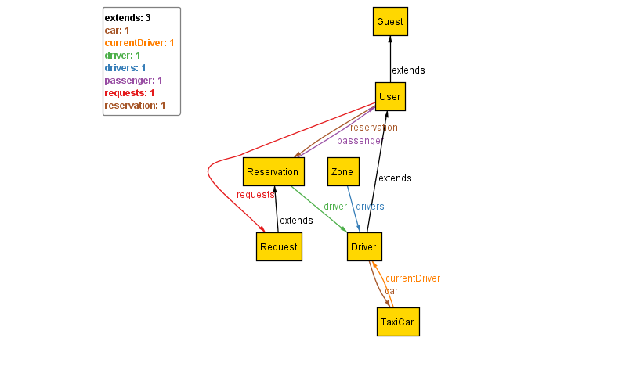
Metamodel
Main constraints of the application:
Driver belongs only to one zone
Request belongs only to one user
Reservation belongs only to one user
User belongs only to one reservation
Reservation belongs to one driver
Taxi car belongs to one driver
Driver have only one taxi car

Slide 30
Used tools
Microsoft Office Word: to redact and to format this document
Axure RP Pro 7.0: to create the sketches for the interface of the web version of the application
JustInMind Prototyper 6.9.1: to create the sketches for the interface of the mobile version of the application
Draw IO and StarUML: to create the State Charts, the Class Diagram, the Sequence Diagrams and the Use Case Diagram
Alloy Analizer 4.2: to prove the consistency of our model

Slide 31

Questions

Slide 32
Thank you for your attention!

